Slide 1







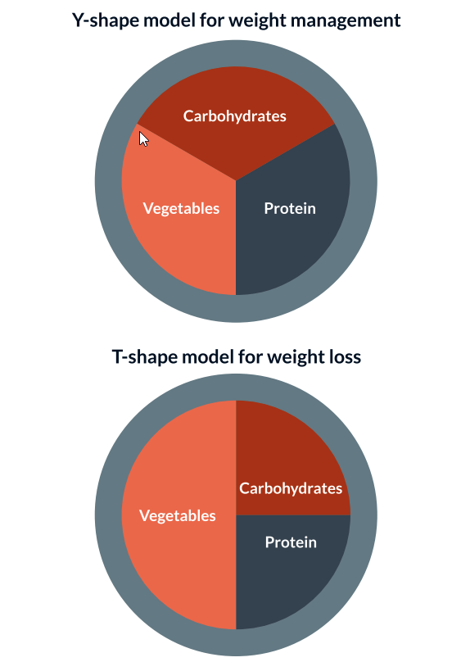
Dietary interventions for people with diabetes
Dietary interventions should aim to:
Control portion sizes to ensure weight loss or maintenance
Minimize consumption of red meat, prioritizing poultry and fish (where appropriate)
Reduce consumption of saturated fat
Increase consumption of fruit and vegetables
Avoid sugar sweetened beverages
Include whole grains, legumes and tree nuts (where appropriate)
Encourage low-moderate alcohol consumption
Building a healthy plate to support portion control in diabetes
If the goal is weight maintenance, use the Y-model
If the goal is weight loss, use the T-model
A lower carb diet may improve glycaemia in people with diabetes
<130g of carbohydrates per day is associated with greater blood glucose reduction, weight loss and rates of diabetes remission at 1 year
than low-fat or low-calorie diets.
Individuals with type 2 diabetes following a
low-carbohydrate diet were 32% more likely to have blood glucose levels close to the normal range and lost 7.41 kg more weight versus those on a low fat/low calorie diet.
Lower carb diets are naturally low in sugar
which is important in diabetes management.
People following a low-carb diet should be
mindful about saturated fat intake.
Examples of low carb food options include:
Meat and fish
Berries
Watermelon
Non-root vegetables (e.g. okra, cauliflower, broccoli, cucumber, tomatoes, aubergine, courgettes, leafy greens)
Eggs
Nuts
Plain yogurt
Cheese
Example global low carb meal plans can be found online.

